Slide 1
Riveting Controller
Student Name: Vishal Srivastava
ID No: 2010A3PS224G
Station Name: Titan Company Ltd.
PS Faculty: Mr. Siju C.R.

Slide 2
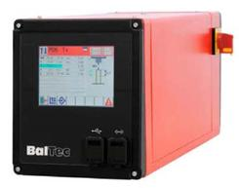
Introduction
Riveting Controller
Riveting controller is a control unit used to control and analyse riveting process.
Basic purpose is to relieve central logic controller (example: PLC) and act as a slave controller.
Various sensors are monitored and based on the various control parameters riveting process is carried out.

Slide 3
Problem Definition/Objectives
Our aim in this project was to design and develop a intelligent standalone control unit which can control this machine as well as log data and produce graphical representation for the same.
The design for this device will be able to manage the following functions:
Manage 5 Digital and 2 Analog Input and Outputs with the minimum scan time of 10 kHz.
Have six program configurations based on the various control perimeters such as head height, force, time etc.
Able to log error reports and at least able to save 38 program configurations

Slide 4
Problem Definition/Objectives
Real time plotting of five input parameters with respect to time.
Able to have a record of various counts such as OK/NOT OK count, No. of operations etc.
A user friendly Graphical User Interface for selecting machine modes based parametric inputs.
Porting of data through Ethernet and USB Drive in spreadsheet format.
Availability of auto compensation modes to be able to reduce deformed and undersized rivets in order to minimize wastage and increase production.

Slide 5
Methodology
Understanding Riveting Process
Steps in the process
Riveting logic with help of its sensor and actuators.
Requirement Identification
Expectations from controller
Decision making for design
Study of Available Solutions
Research for circuit
Compatible components
Design Proposal
Proposal of design
Checking for its feasibility
Small rectifications (if required)
Implementation
Implementing design after corrections

Slide 6
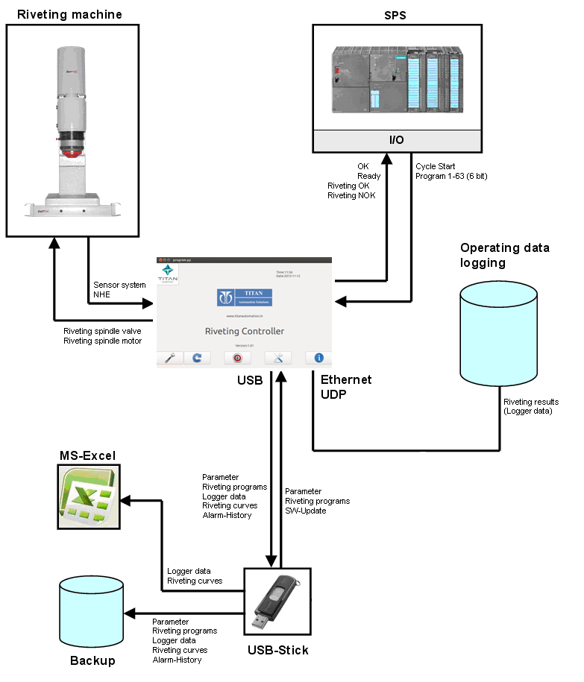
Block Diagram

Slide 7
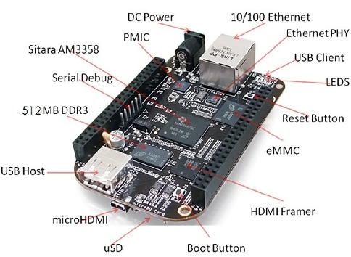
Primary Components
Beaglebone Black

Slide 8
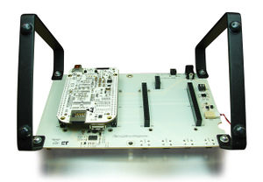
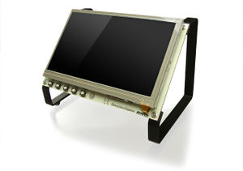
Primary Components
7’’ LCD Screen
Front side
Back Side

Slide 9
Current Status of Project
Development for GUI Interface has been completed with all the required features.
Backend program engine needs to be tested.
Linking of program with Linux OS needs to be done.
Linking Hardware with the program engine needs to be done.

Slide 10
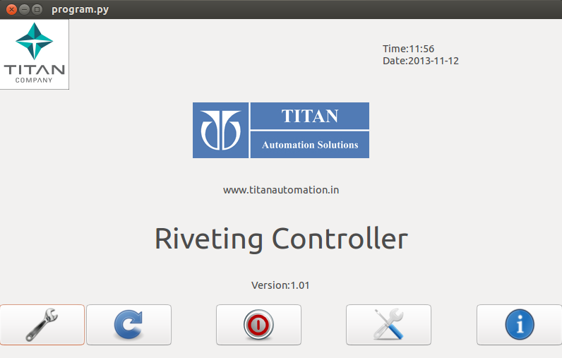
GUI Screens
Home Screen
First Screen Visible
Used to select riveting process and change settings
Can be used to shutdown the system

Slide 11
GUI Screens
Riveting Process is characterised using the following parameters:
S: Control variable forming path [mm]
Control with reference input variable riveting path (forming path).
T: Control variable forming time [s]
Control with reference input variable riveting time (forming time).
F: Control variable forming force [kN]
Control with reference input variable riveting force.
E: Control variable spindle path [mm]
Control with reference input variable spindle path.
N: Control variable external contact
Control with reference input variable external contact.
H: Control variable driven head height
Control with reference input variable driven head height.

Slide 12
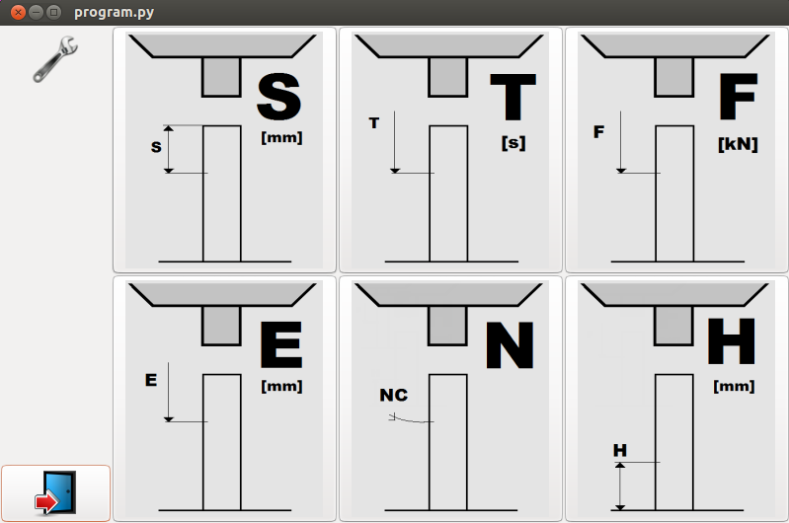
GUI Screens
Mode Selection Screen
Used to select type of Riveting process
Type of Riveting process based on control parameters

Slide 13
GUI Screens
S Mode can be divided on the basis of different combination of sensors
Riveting mode | Description | Path sensor at riveting spindle | Pressure sensors | Projection measurement NHE | External NA
S1 | S controlled after detection of NA NA, T and F monitored | ✓ | ✓
S2 | S controlled after detection of NA NA, B, U, T and F monitored | ✓ | ✓ | ✓
S3 | S controlled after detection of NA NA detection by external signal NA, T and F monitored | ✓ | ✓ |  | ✓
S4 | S controlled after detection of NA NA detection by external signal NA and T monitored | ✓ |  |  | ✓

Slide 14
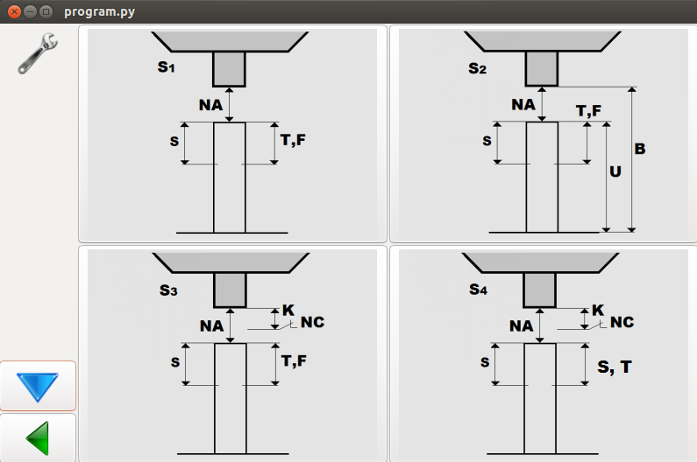
GUI Screens
S Mode selection Screen
Used for selection of type of S type riveting
Various S modes based on various control parameters

Slide 15
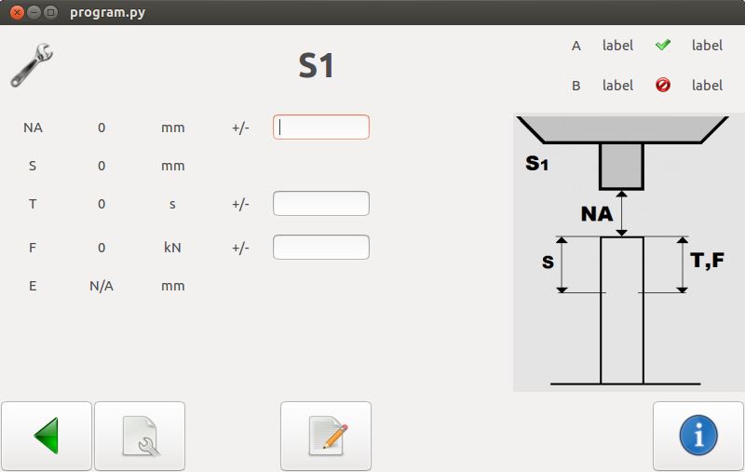
GUI Screens
S1 Setup Screen
Used for calibrating auto adjust settings
Can set tolerance for auto adjust mode

Slide 16
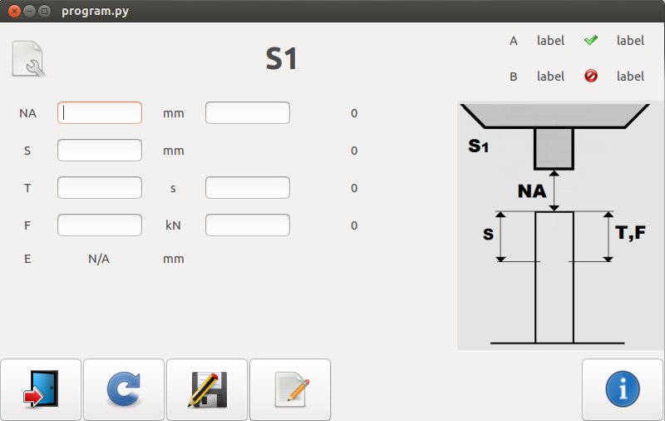
GUI Screens
S1 Configure Screen
Used for changing control parameters for testing purpose
Can save programs

Slide 17
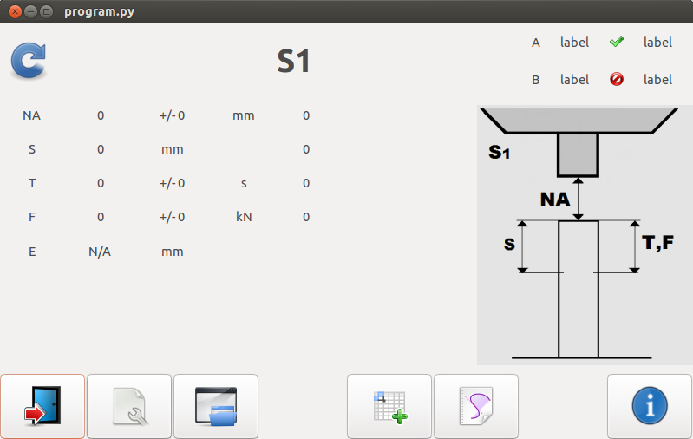
GUI Screens
S1 Cycle Screen
Used for displaying reading during a cyclic process
Can be used to obtain graphs and table for readings for a process cycle
Can be used to load already saved programs

Slide 18
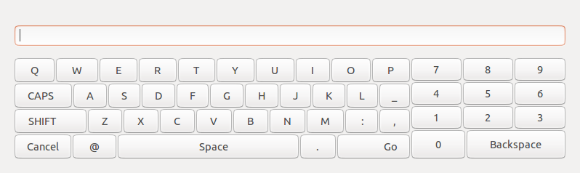
GUI Screens
Keypad
Used to enter various parameters

Slide 19
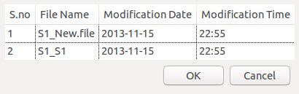
GUI Screens
Load Program Dialog
Used to view saved programs related to certain riveting mode.
Can be used to check for details of the program

Slide 20
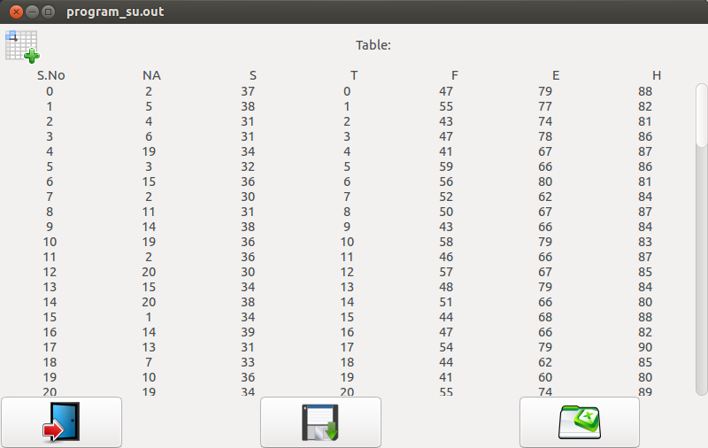
GUI Screens
Table
Used to view all readings for the control parameters for each of a single process cycle
Can be saved or exported to excel file

Slide 21
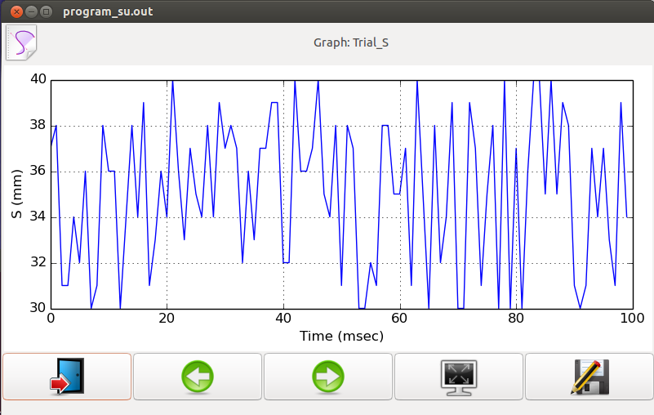
GUI Screens
Graph
Used to view graph for all the control parameters with respect to time.
Can be switched to full screen mode or exported to a flash drive

Slide 22
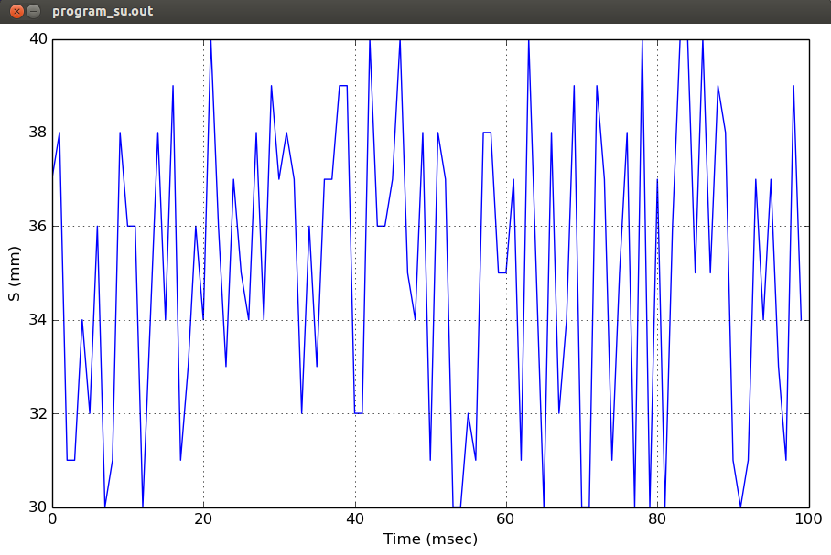
GUI Screens
Graph Full Screen
Used to provide Full screen view to the respective graph

Slide 23
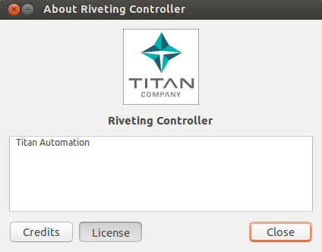
GUI Screens
Dialog
Can be used to check for software details and details of manufacturer

Slide 24
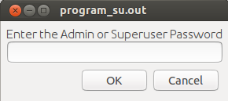
GUI Screens
Login Dialog
Used to provide authorized access to settings and software control parameters
To avoid accidental changes

Slide 25
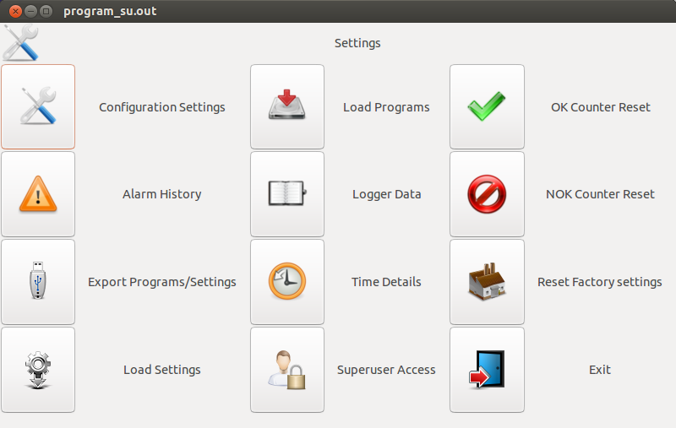
GUI Screens
Settings
Can be accessed by Admin or Superuser.
Can be used to configure various software related parameters and settings

Slide 26
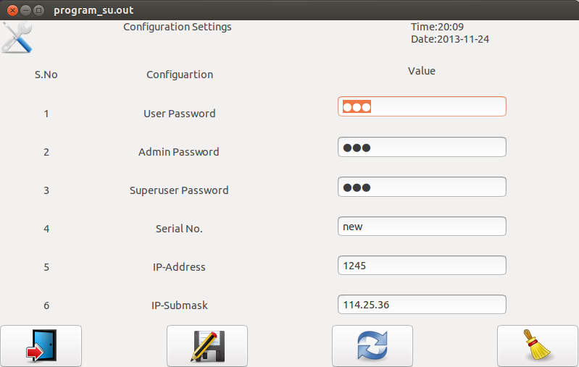
GUI Screens
Configuration Settings
Used to configure various passwords, serial no, IP etc.
Can be used to clean all the program memory

Slide 27
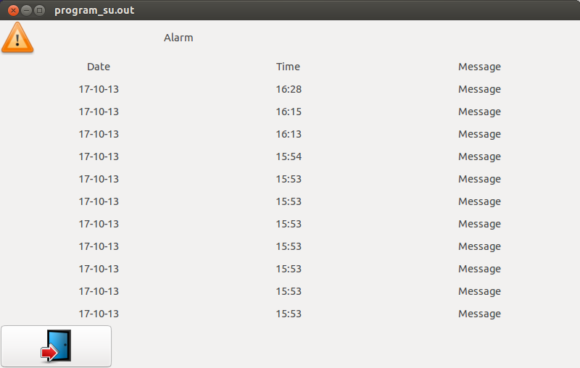
GUI Screens
Alarm
Used to view various alarms and warnings caused during the operation

Slide 28
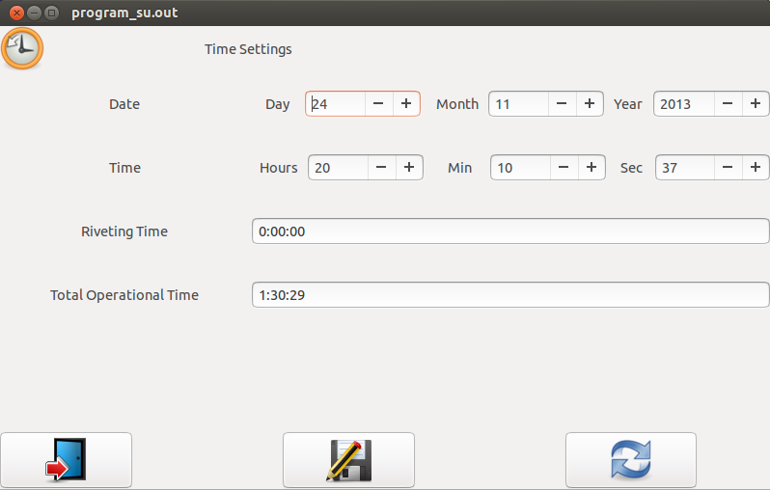
GUI Screens
Time Settings
Set system date and time
Riveting Timer Reset
Operation Timer Reset

Slide 29
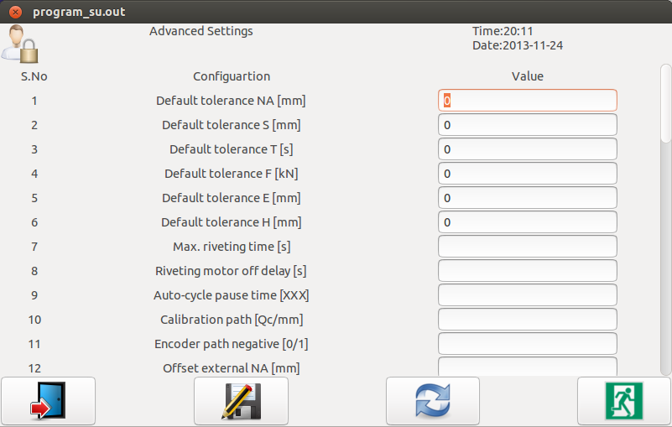
GUI Screens
Advanced Settings
Accessible to only Superuser
Can be used to set advanced parameters
Also can be used to interact with Operating System

Slide 30
Program Flow

Slide 31
Program Flow

Slide 32
Summary and conclusion
The designing and programming for the Riveting controller has already been completed
Still waiting for the components
After fabrication is done prototype testing has to be carried out for all the types of inputs and outputs.
Prototype development carried out to test capability within the available infrastructure.
Actual product development outsourced to TATA ELIXSI.

Slide 33
Acknowledgement
I am thankful to Mr. Ravidas Bhatt, Electrical Head, Center of Excellence, to provide me with this rare opportunity of involving me in this product development. He have constantly provide me with support in this project.
I also like to thank Mr. S Rajesh for providing help in the circuit designing and components selection for the project. His constant inputs for the project has made fabrication of design possible.
I also like to thank Mr. Siju C.R. for guiding us in this project layout.

Slide 34
Thank You

